Slide 1


REVIEW ANALYZER
AI-FEST
Project Evaluation
Salman Ali Rajput
Parsanta Lal
Instructor: Zahid Hussain
Industry Partner: Bahawal baloch
Department of Computer Science - DHA Suffa University

Slide 2


Summary
Project Brief Introduction
Problem Statement
Dataset Description
Project Scope
ML/DL/NLP Model Details
Results and Discussions
Tools and Technologies Learnt During the Project Implementation (Individual Skills Set)
Project Demo
References (last accessed)

Slide 3
Project Brief Introduction
Objective:
Analyze the sentiment of customer reviews and provide insights into their sentiment (positive or negative). For negative reviews, generate a complaint indicating the relevant department and predict the stars on the basis on the review
Key Features:
Sentiment Analysis: Classify reviews as positive or negative.
Complaint Generation: Automatically generate complaints for negative reviews.
Department Classification: Determine which department the complaint should be directed to.
Predictive Rating: Estimate the star rating based on the sentiment analysis.

Slide 4
Problem Statement
Challenges For e-commerce vendors:
Increasing Volume of Reviews: With the growth of online platforms, businesses face a deluge of customer feedback, making manual review analysis inefficient and time-consuming.
Understanding Sentiment: Interpreting the sentiment of reviews accurately is crucial for businesses to gauge customer satisfaction and make informed decisions.
Actionable Insights: Businesses need actionable insights from reviews, such as identifying areas for improvement and addressing customer concerns promptly.

Slide 5
Problem Statement
Current Limitations:
Manual Processing: Current methods rely heavily on manual review reading and interpretation, leading to delays and potential oversight of critical feedback.
Subjectivity: Interpretation of sentiment can vary among individuals, leading to inconsistencies in feedback analysis.

Slide 6
Problem Statement
Solution Approach:
Automated Sentiment Analysis: Implementing a system that automates sentiment analysis to categorize reviews as positive or negative.
Complaint Generation: Automatically generating complaints for negative reviews to streamline issue resolution and feedback handling.
Predictive Rating: Predicting star ratings based on sentiment analysis to provide a quick overview of customer satisfaction levels.

Slide 7
Dataset Description
The dataset for this project is consist of product reviews collected from Kaggle. Each review will include fields such as:
Review Text: The textual content of the review.
Rating: The rating given by the customer (optional but useful for additional sentiment analysis).
The dataset is preprocessed to clean the text, remove noise,balance the category of positive and negative and standardize the format for further analysis. A labeled subset of the data will be used to train and evaluate the sentiment analysis and department classification.

Slide 8
Project Scope
1. Sentiment Analysis:
Utilize natural language processing (NLP) techniques to analyze textual data and extract sentiment.
2. Complaint Generation:
Identify keywords and context to determine the relevant department for each complaint.
3. Predictive Rating:
Use historical data and sentiment analysis results to predict the star rating a review is likely to receive.

Slide 9
Project Scope
4. Integration and User Interface:
Design a user-friendly interface for testing, input and view review sentiment and complaints.

Slide 10
ML/DL/NLP Model Details
Bidirectional LSTM Model
Type: Recurrent Neural Network (RNN) architecture for sequential data.
Functionality: Analyzes review sentiment (positive/negative).
Implementation: Built using TensorFlow/Keras for efficiency.
Benefits: Captures context from both past and future states for accurate sentiment analysis.
Integration: Deployed within Review Analyzer for real-time review processing.

Slide 11
Results and Discussions
Model Evaluation
Models Tested: Simple neural network, Random Forest, CNN, LSTM, Bidirectional LSTM.
Best Performing Model: Bidirectional LSTM.
Accuracy: Achieved 92% accuracy in sentiment analysis.
Reason: Captures bidirectional context for nuanced sentiment understanding.

Slide 12
Results and Discussions
Integration with Frontend
Implementation: Successfully integrated Bidirectional LSTM model with frontend.
User Experience: Provides real-time sentiment analysis and complaint generation.
Discussion
Advantages: Bidirectional LSTM excels in capturing sequence dependencies, crucial for accurate sentiment classification.
Challenges: Ensuring scalability and real-time performance in production.
Future Steps: Continuous model refinement and updates to enhance accuracy and user experience.

Slide 13
Tools and Technologies Learnt During the Project Implementation
Machine Learning Models:
Explored and implemented various models including SimpleRNN, Random Forest, CNN, LSTM, and Bidirectional LSTM.
Gained insights into the strengths and weaknesses of each model type for sentiment analysis.
Deep Learning Techniques:
Learned to build and optimize neural networks using TensorFlow/Keras.
Applied techniques such as bidirectional processing in LSTMs for capturing context in text data.

Slide 14
Tools and Technologies Learnt During the Project Implementation
Natural Language Processing (NLP):
Used NLTK and SpaCy for text preprocessing, tokenization, and advanced NLP tasks.
Developed an understanding of text representation techniques like word embeddings.
Version Control and Collaboration:
Utilized Git/GitHub for version control, collaboration with team members, and managing project milestones.

Slide 15
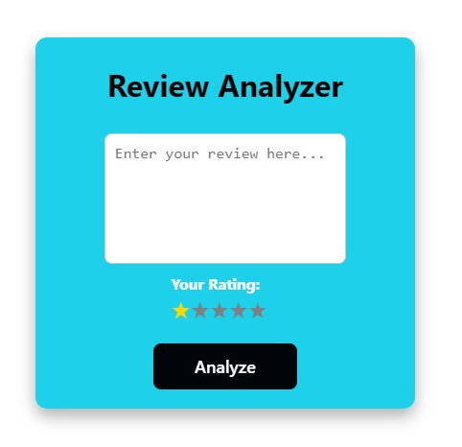
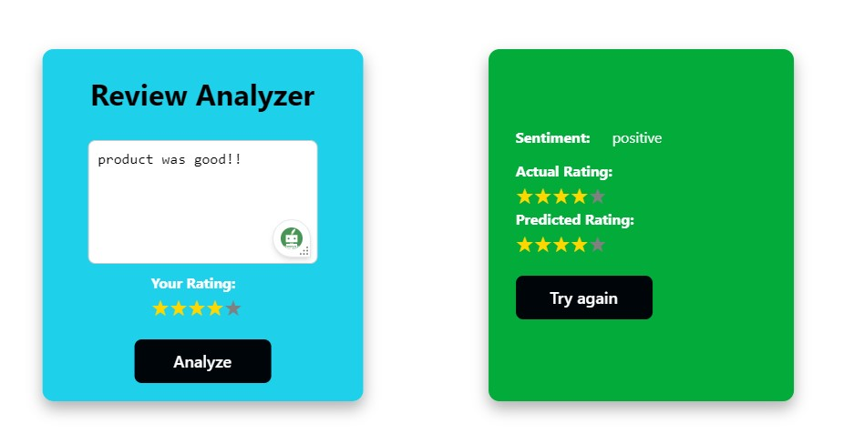
Project Demo

Slide 16
8- Reference
Journal reference
C. Zhang, T. Liu, Z. Wang, et al., "A deep learning model for automatic detection of acute leukemia." PeerJ Computer Science (2023), https://doi.org/10.7717/peerj-cs.1976.

